Slide 1

Zip Function

Slide 2
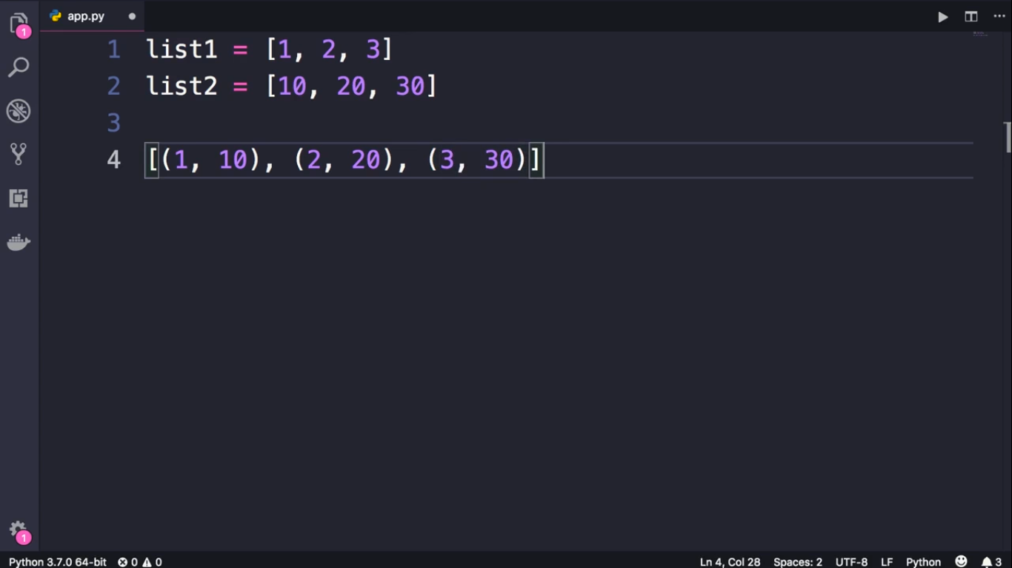

Slide 3
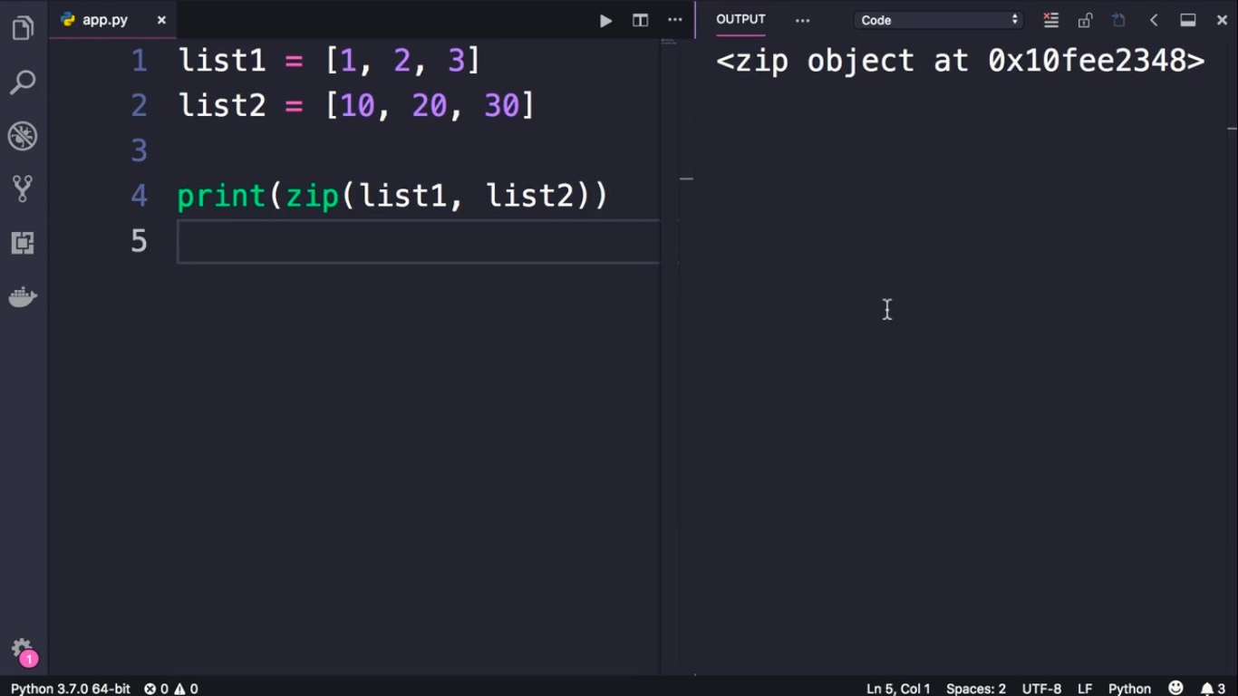

Slide 4
